Slide 1


Supply-Demand Gap Assignment Submission
Presented By:
Anupam Majhi

Slide 2
Abstract : UBER Demand-Supply Gap
Problem Statement
Driver Cancellations and Non-Availability of cabs to and from Airport leading to loss of potential revenue.
Objective
To identify the Supply-Demand gap in cabs from Airport to City and vice versa.
Research Questions
Identify the most pressing problems for Uber.
What is the gap between supply and demand to and from Airport.
What might be the reason for this supply-demand gap?
Recommend some ways to improve the supply-demand gap.
Data Used for Analysis
The data used is only to and from Airport
Analysis has been done on data of 5 days.

Slide 3
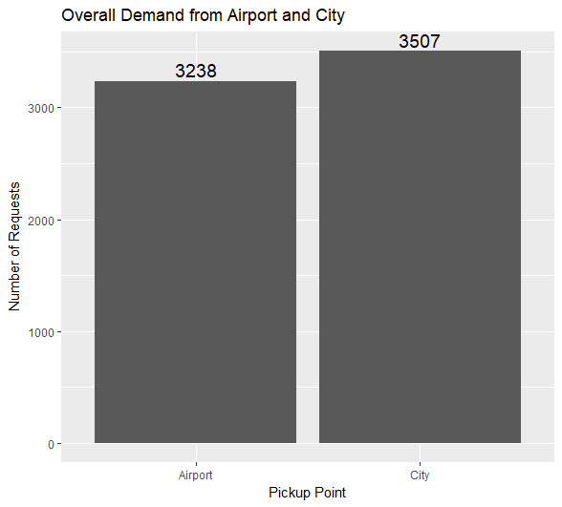
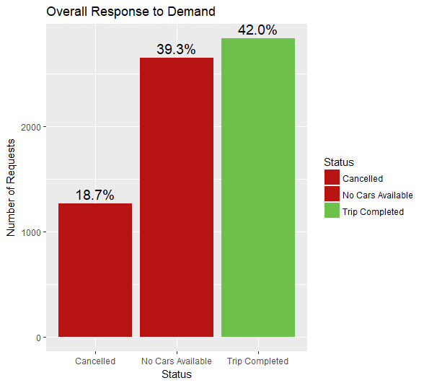
The Problem
The Demand for cabs is equivalent both from Airport to City and vice versa.
There is a huge gap in Supply as only about 42% of the requests are fulfilled.
There is a gap of 58% in the supply of cabs.
About 39.3% shortage in cabs availability in the concerned areas and 18.7% trips cancelled.

Slide 4
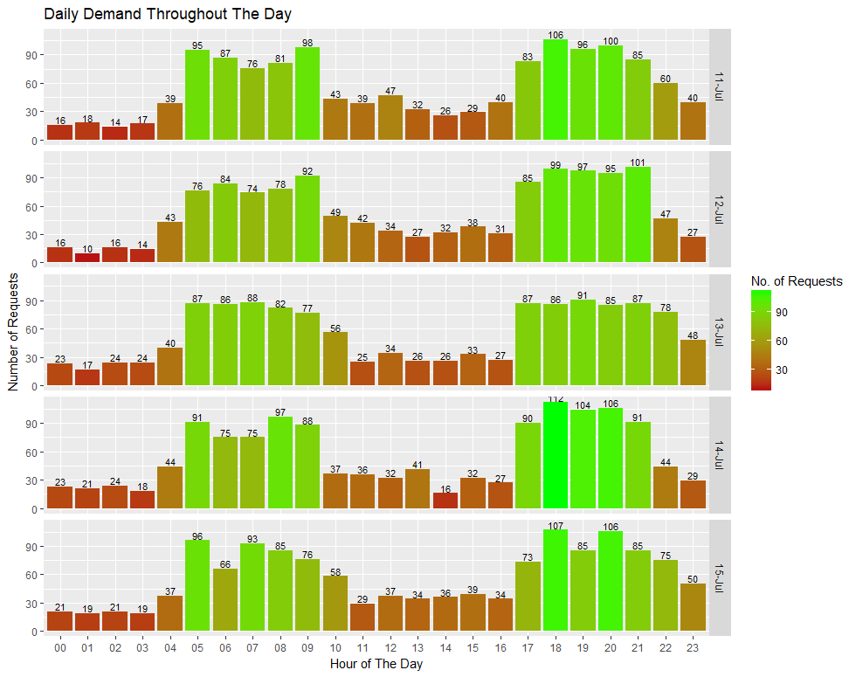
Overall Demand Based on Date and Time
Irrespective of days, it is clearly seen that the demand is high demand of cabs mainly in:
Morning (5am to 10am)
Late Evening and Night (5pm to 11pm)

Slide 5
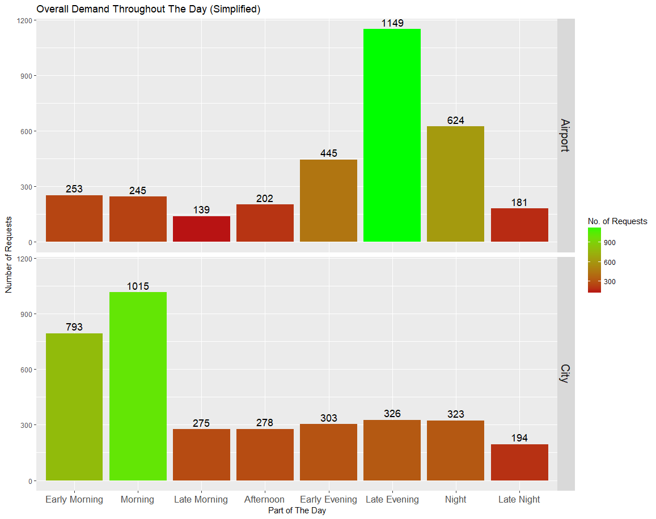
Demand Based on Time and Location
There is a high demand of cabs from
City to Airport
in the Early Morning and Morning hours.
There is a high demand of cabs from
Airport to City
in the Late Evening and Night hours.
This means there are chance of having :
more Outbound flights in the Early Morning and Morning. Hence more customers going to Airport and less customers coming to City.
more Inbound flights in the Late Evening and Night. Hence more customers coming to City and less customers going to Airport.

Slide 6
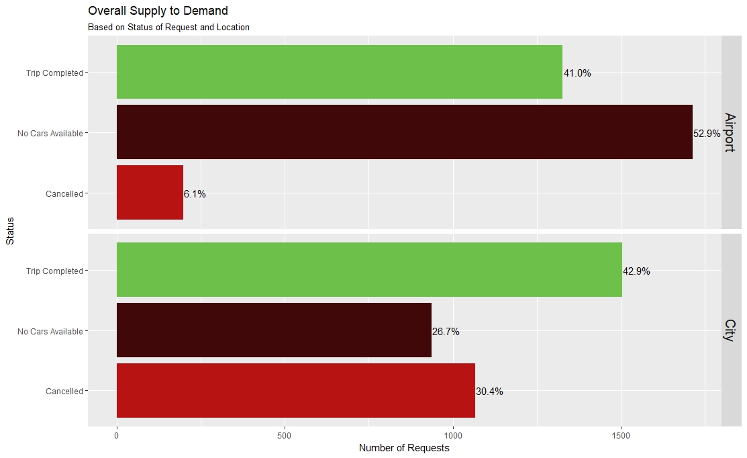
Supply Based on Location
Airport to City :
52.9% face Non-Availability
Shortage of cabs around Airport
City to Airport :
30.4% requests Cancelled
Cabs denying services
26.7% face Non-Availability
Shortage of cabs in city

Slide 7
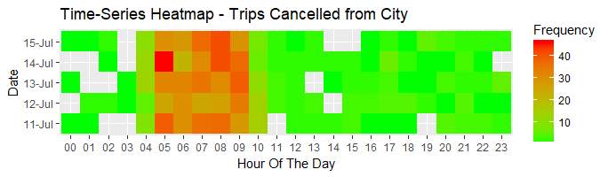
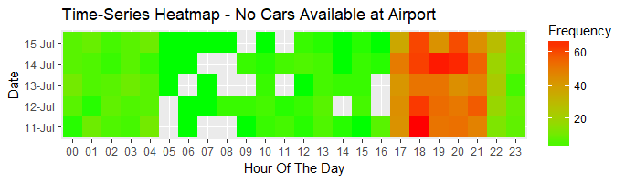
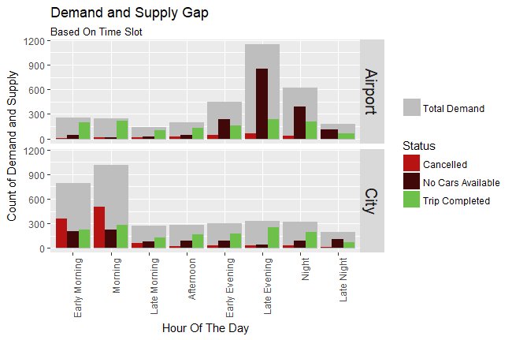
Demand and Supply Gap
Heatmaps show us that the responses to the demand is similar everyday throughout the available data.
The bar graph also show us the following:
Airport to City (Late Evening and Night) :
High Demand
Low Supply
Not enough cabs go towards Airport to meet the demands
City to Airport (Early Morning and Morning) :
High Demand
Low Supply
Cabs denying services as not enough demand from Airport to meet the influx of cabs
Also not enough cabs to meet the demand

Slide 8
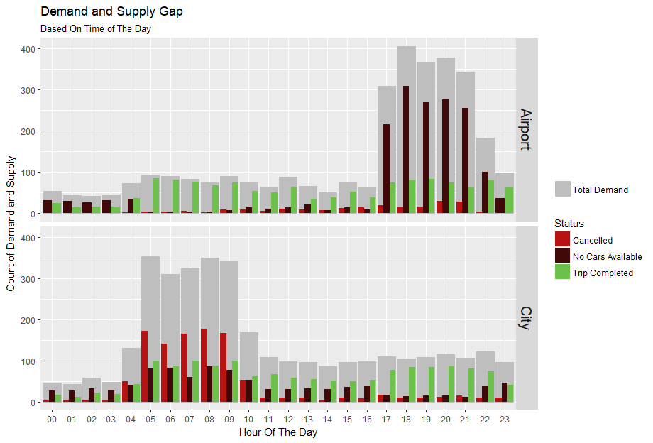
Demand and Supply Gap – The Reason
What is the reason for this supply-demand gap?
The flow of traffic is one-directional due to flight timings.
Early Morning and Morning : High demand from City, but low demand from Airport. Hence it’s risky/less opportunity for drivers to get return trip to City and the trips are cancelled.
Late Evening and Night : High demand from Airport but not enough cars around as less number of cars go towards airport in evening.
There is a shortage of cabs in general. At the peak times there is about 26% chance of Non-Availability of cabs both to and from Airport.

Slide 9
Possible Solutions and Recommendations
It was found the demand at peak times is mostly unidirectional and demand at destination around that was not enough for return trips for drivers.
It is recommended to provide incentives to drivers for trips to and from Airport during these rush hours (i.e. 5am to 11am and 5pm to 11pm).
During these rush hours customers can be charged higher for trips to and from Airport.
It was also observed that there is a shortage of cabs in general. Though the reason of shortage from Airport is not enough organic supply to the airport, but from city as well, overall about 26.7% requests face Non-Availability of cabs.
Avg. Non-Availabilty hourly:
Airport = 71
City = 39
Hence based on the available data a new fleet of 40-70 cabs can added to Uber services.
The average time of travel is 52.4 minutes for these trips.
Incentive based on distance of trips will encourage drivers to take these trips. This would make a better financial sense for drivers.
Accordingly longer trips should be charged.
Incentivising these trips will in turn meet more customer demands, resulting in better profits for Uber.
Educating drivers about these demand-supply gap.

